Slide 1
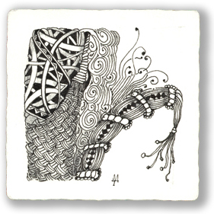
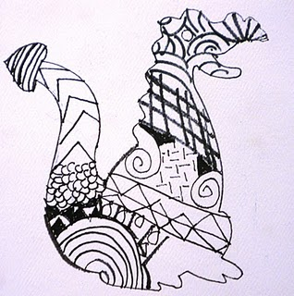
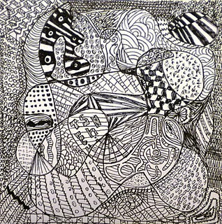
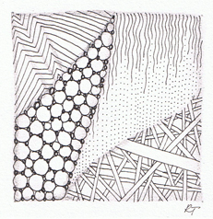
ZINTANGLES…
…are all the RAGE right now!
K. Silvestri 2011

Slide 2
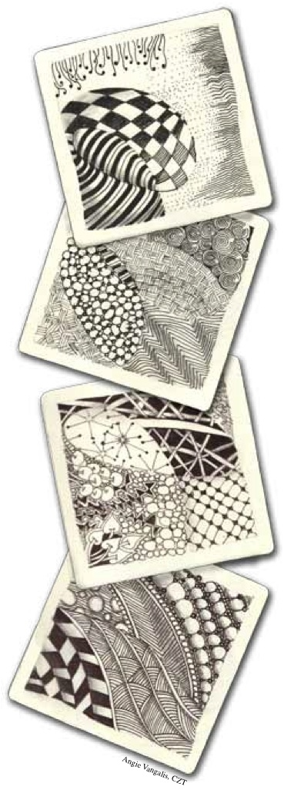
Zintangle artists typically make their designs on small trading cards.
But you can make yours any size that you wish!

Slide 3
What is it?
Zentangle is an easy to learn method of creating beautiful images from repetitive patterns.
It is a fascinating new art form that is fun and relaxing.
It increases focus and creativity.
Zentangle provides artistic satisfaction and an increased sense of personal well being.
Zentangle is enjoyed by a wide range of skills and ages and is used in many fields of interest.
http://gpa-art-room.wikispaces.com/Zentangles

Slide 4
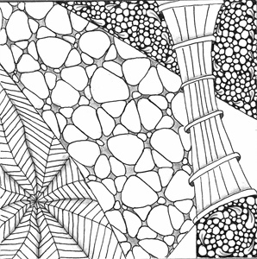
You cannot fail to create a Zentangle.
That is because a Zentangle is meant to look like a Zentangle. It does not need to look like anything else and has no up or down.
http://gpa-art-room.wikispaces.com/Zentangles

Slide 5
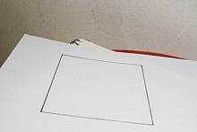
How to Make a Zintangle http://www.wikihow.com/Make-a-Zentangle
Draw a border outlining the shape of your zentangle.
It is very common to use a square shape.
The shape is usually relatively small (about 3 inches wide) as most zentangles are drawn in one sitting.
Mrs. Silvestri’s note: You DON’T have to start with a square! Start with a circle or a triangle or a blank picture from a photo album! Trace your hand and work with that! DO WHATEVER YOU WANT!

Slide 6
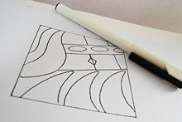
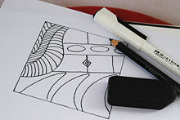
Draw strings.
Strings are lines that divide the shape into individual sections.
Fill one section with a repetitive pattern.
Don't spend too much time planning the pattern, just draw.

Slide 7
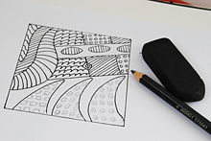
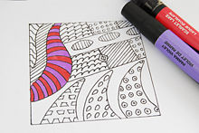
Repeat with each section. Change the pattern with each section.
Add color or shading as desired.

Slide 8
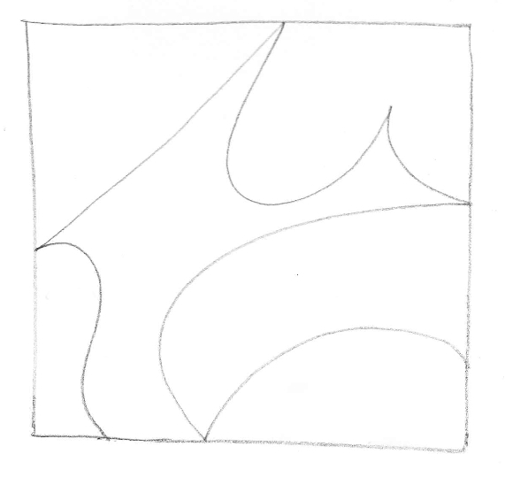
You try: Start with a STRING

Slide 9
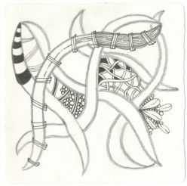
Fill in the sections with patterns

Slide 10
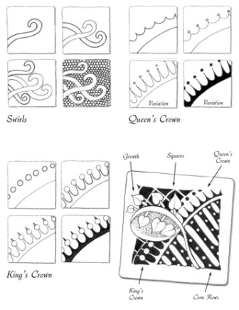
There are A LOT of different patterns.
You can google “zintangle patterns”…
…or find tangle patterns all around you!

Slide 11
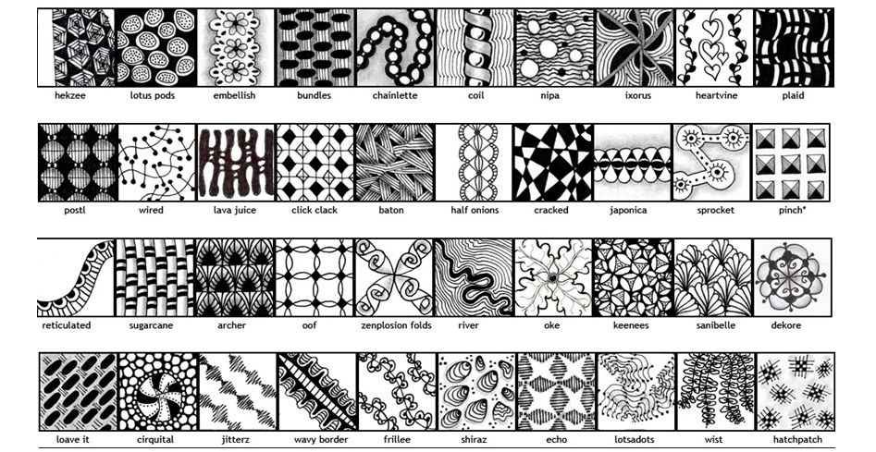
These are just a few patterns you can find at www.tanglepatterns.com

Slide 12
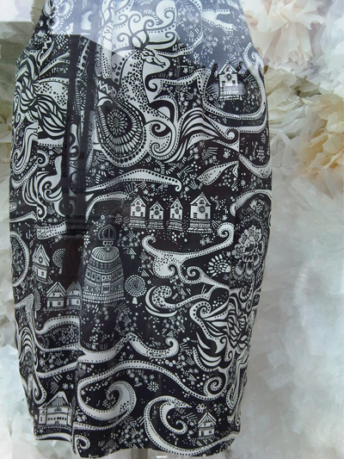
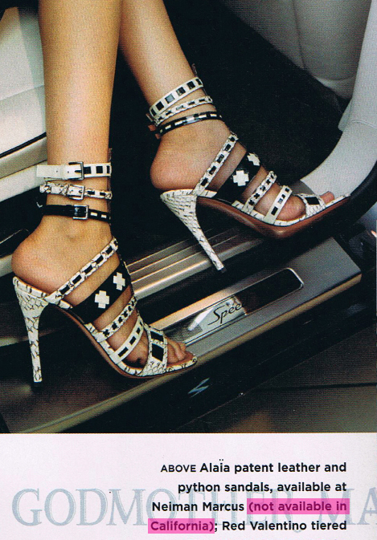
Zintangles are Everywhere
ON CLOTHING!

Slide 13
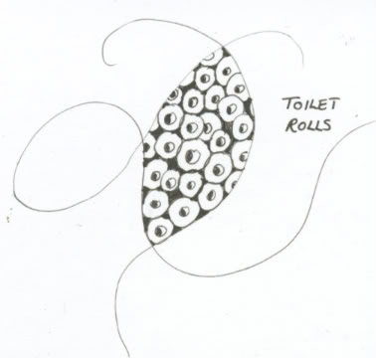
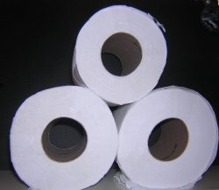
Zentangle Ideas - How to Find Them
In the bathroom!

Slide 14
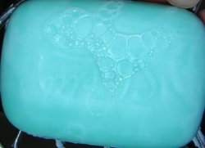
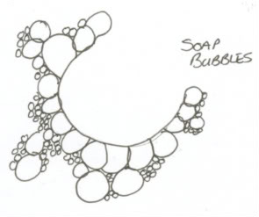
They are there - you just have to look

Slide 15
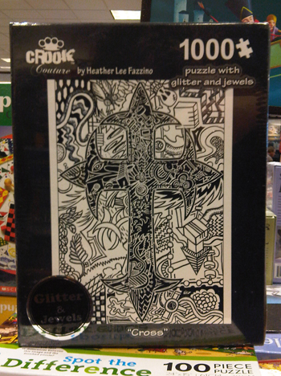

Slide 16
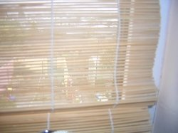
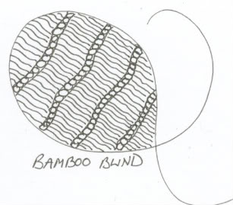
In the Living Room!

Slide 17

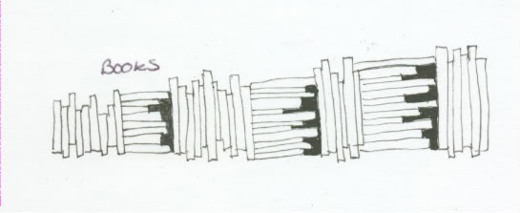
This 'book' Zentangle would make a great border, either around other patterns or around a page of text.

Slide 18
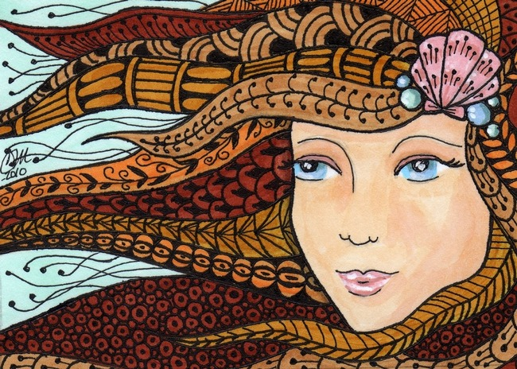
I just LOVE this one!

Slide 19
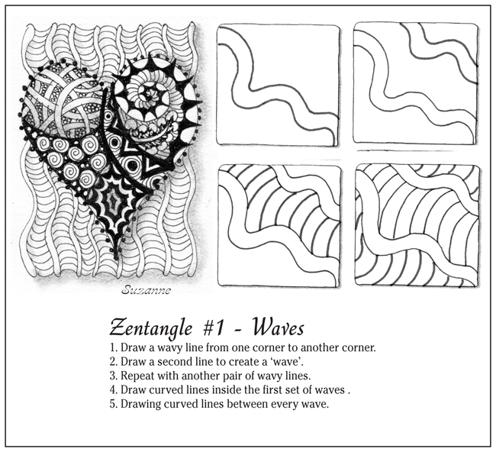
PATTERNS

Slide 20
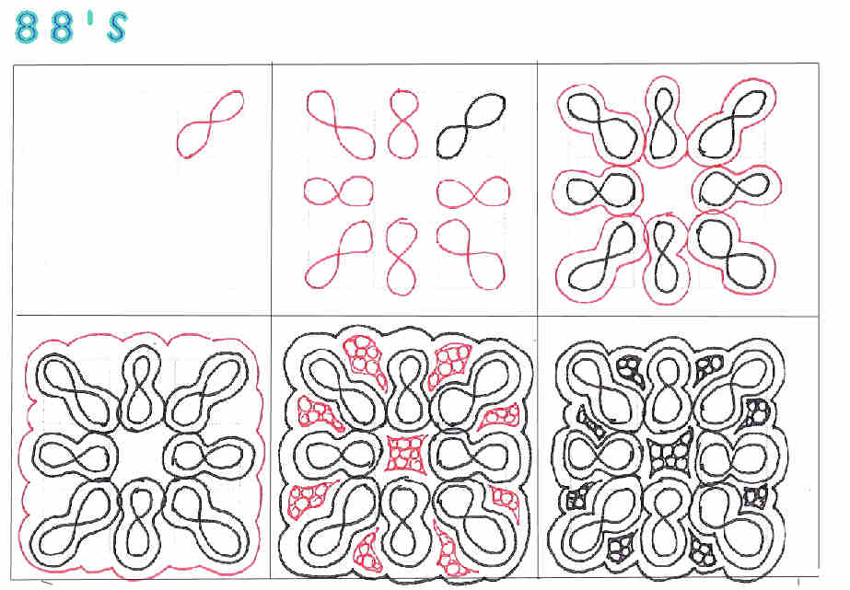
PATTERNS

Slide 21
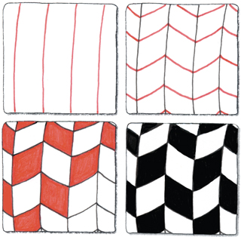
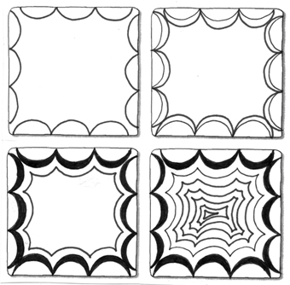
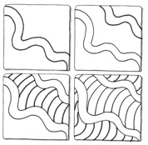

Slide 22
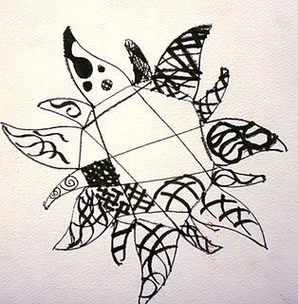
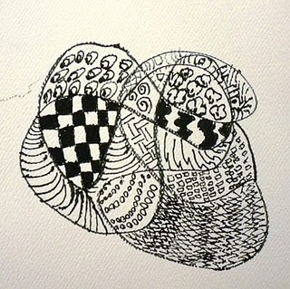
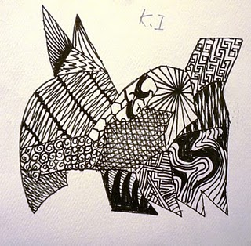
The Sky is the Limit!
You Can’t Mess Up a Zintangle….
….because they are already TANGLED!

