Slide 1
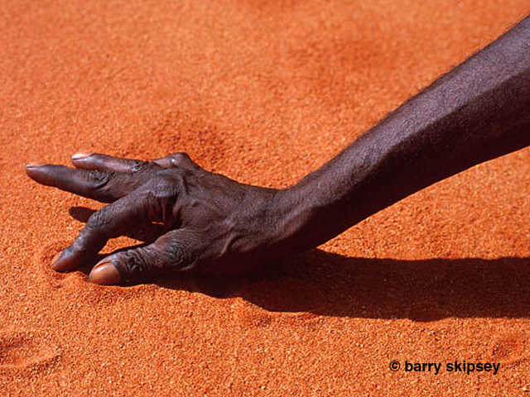
Aboriginal Dot Painting

Slide 2
WHY DOES AN ARTIST PAINT THE SAME SUBJECT AGAIN AND AGAIN?
Traditional Aboriginal artists paint their Dreaming, story or totem.
Unlike western artists, Aboriginal artists are not at their own free will to paint whatever subject matter they like - they should only paint subject matter which they are permitted to paint as determined by the elders of their community.
Traditional Aboriginal people are usually given one or more stories or totems by the community elders when they're very young. It is their responsibility to learn every aspect of this part of their culture and they effectively become the custodians of this aspect of their culture which ensures that culture is not lost and is passed on from generation to generation.

Slide 3
Each artwork is original in its execution because it is not identical to any other painting - however, it may be of the same subject matter. Each painting will differ in the size, scale or detail. Importantly, each artwork is hand-painted by the artist.
The key difference between western artists and traditional Aboriginal artists are the cultural constraints in which Aboriginal artists paint.
However, many people see this difference as a distinct advantage and particular stories or totems painted by Aboriginal painters have become highly collectable.
http://www.artery.com.au/faq.php

Slide 4
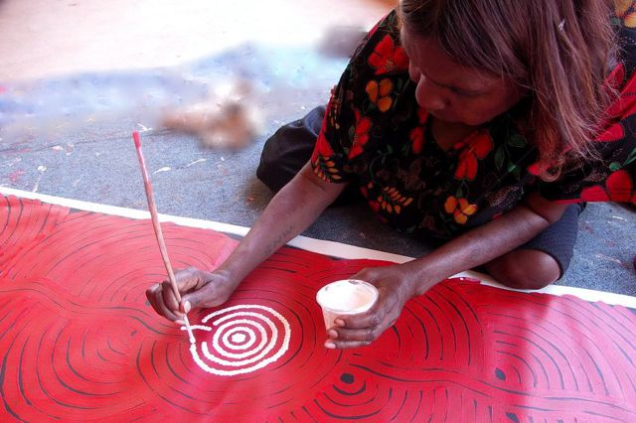

Slide 5
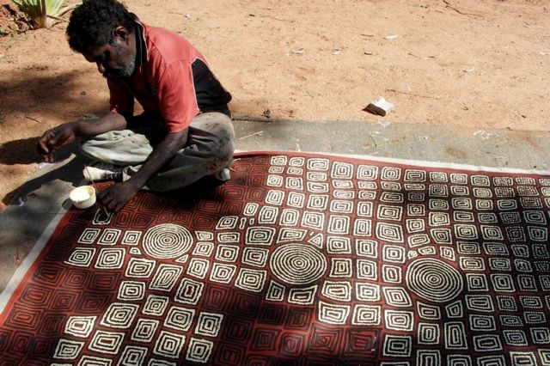

Slide 6
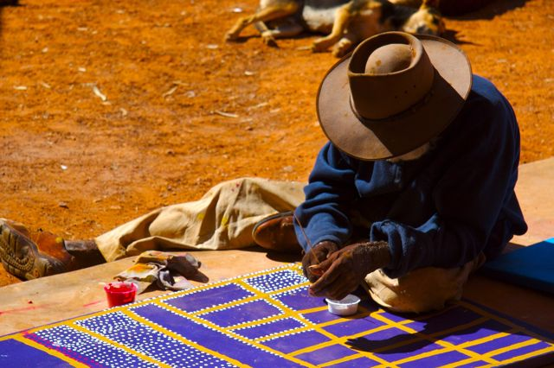

Slide 7
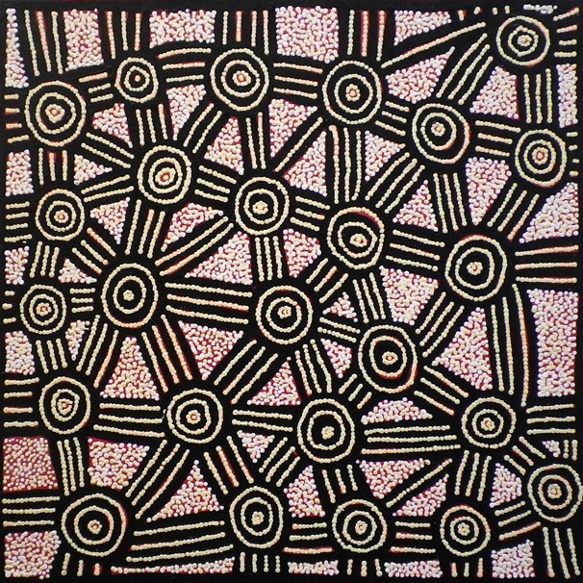
Kim Butler Napurrula is a Pintupi woman from Tjukurla, located to the west of Alice Springs, just over the WA border.
Kim’s works are primarily depictions of ‘Her Country’, representing the sacred women’s sites between the communities of Kintore and Kiwirkurra in the Western desert of Central Australia.

Slide 8
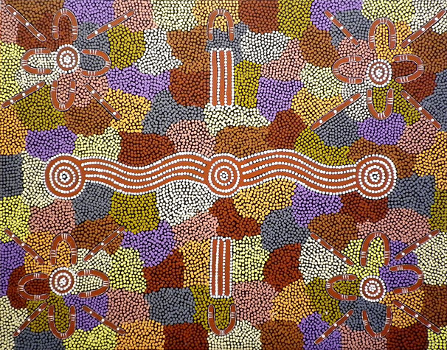
Doreen is a senior Warlpiri woman from Willowra, Central Australia, and comes from a long line of artists, including internationally renowned, Janet Long Nakamarra.
Doreen utilises traditional iconography and carefully executed dot work.
Iconography are an essential part of traditional story telling, they are the visual form by which Aboriginal people convey their important information and knowledge.

Slide 9
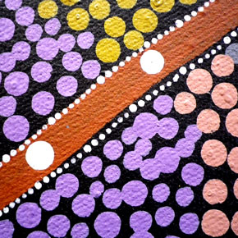
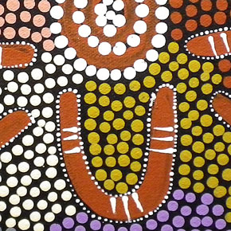
Close up shots of Doreen’s work

Slide 10
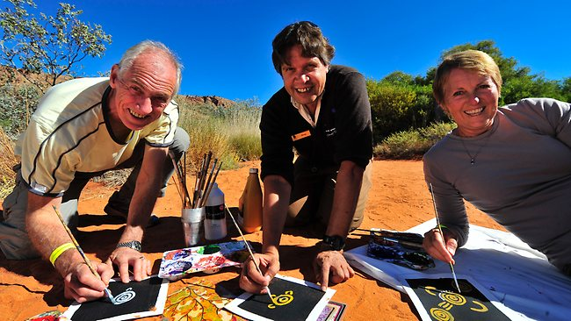
Some tourists learning dot painting

Slide 11
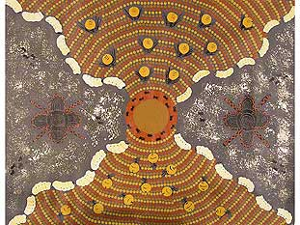
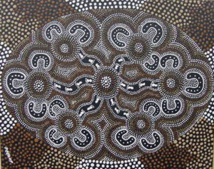
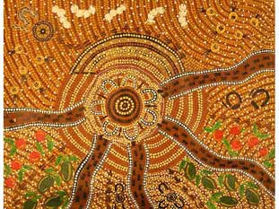

Slide 12
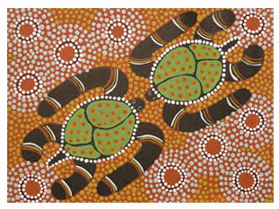
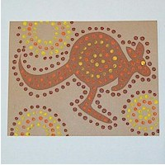
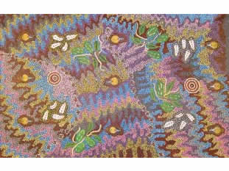

Slide 13
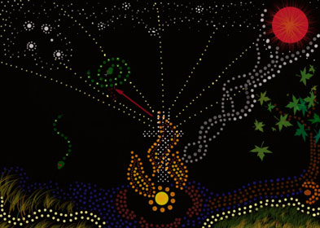
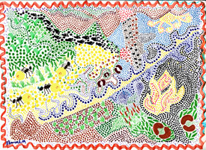
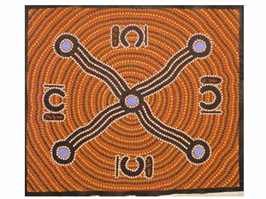
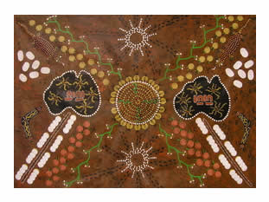

Slide 14
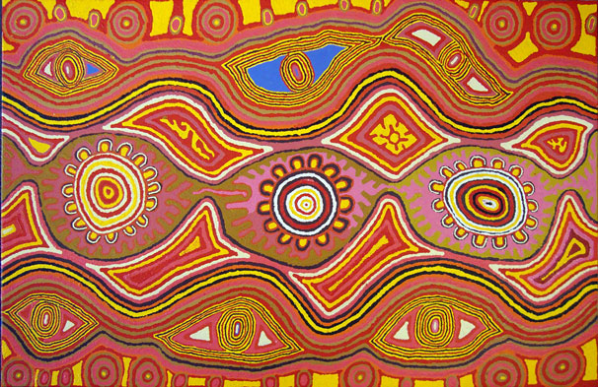

Slide 15
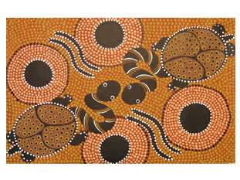
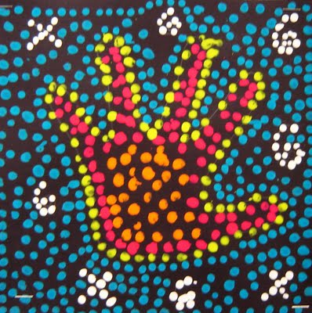
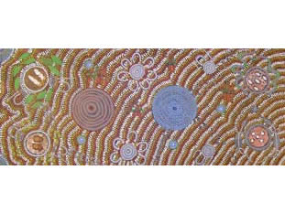

Slide 16

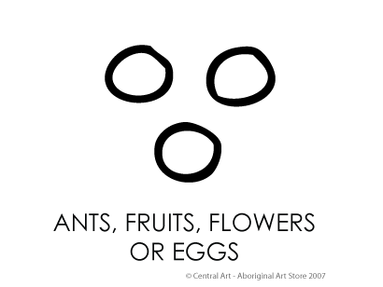
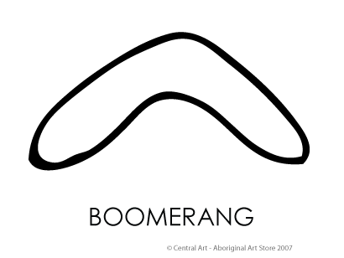
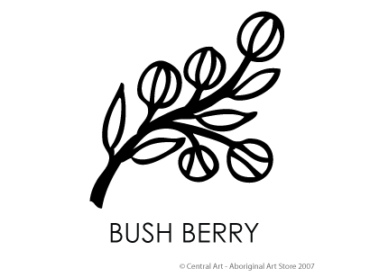

Slide 17
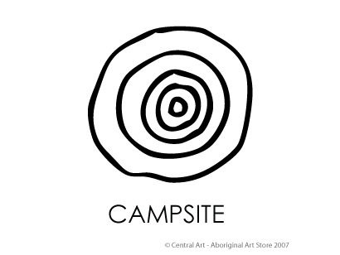
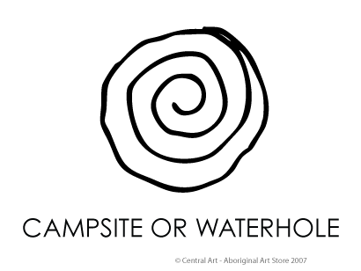
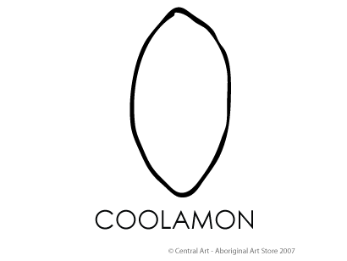
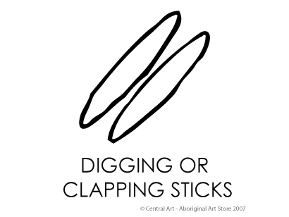

Slide 18
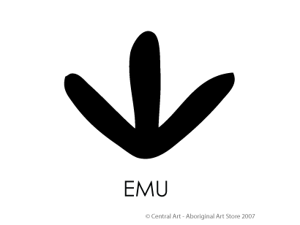
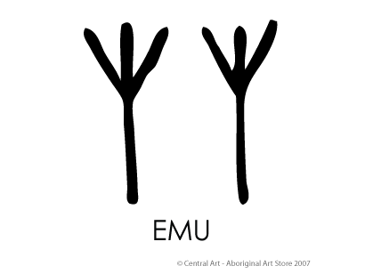
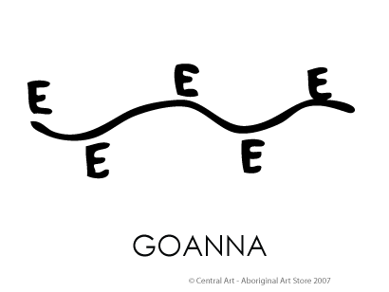
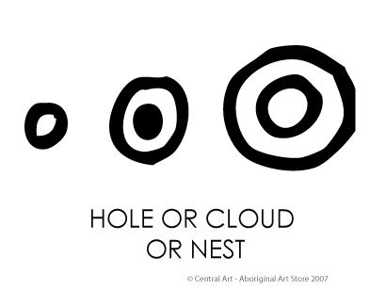

Slide 19
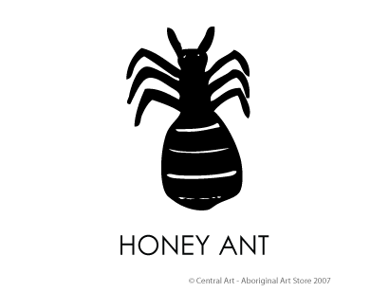
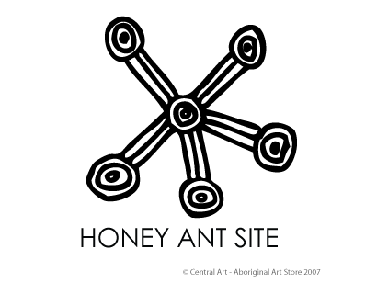
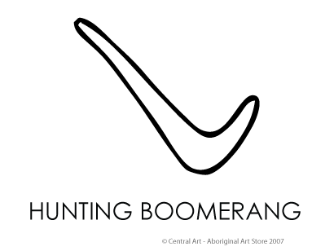
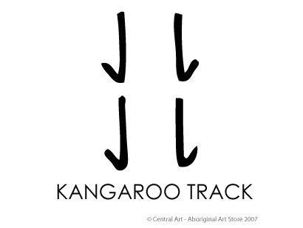

Slide 20
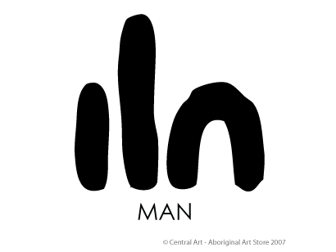
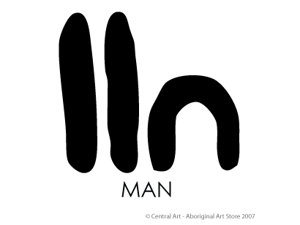
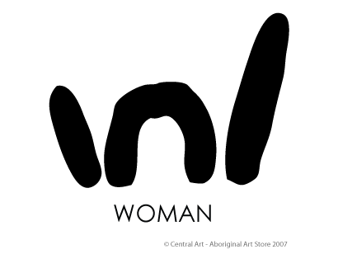
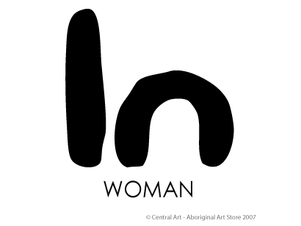

Slide 21
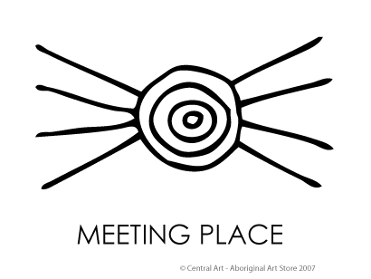
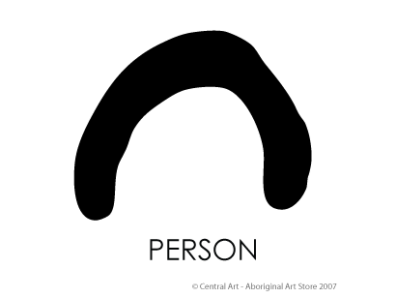
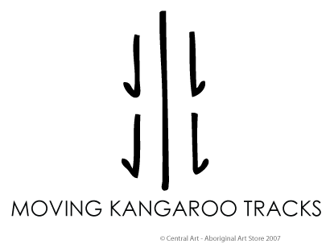
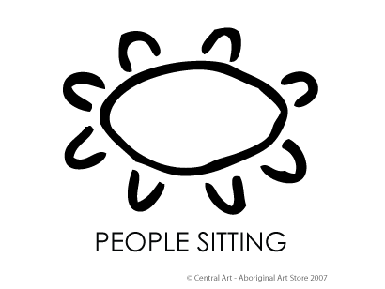

Slide 22
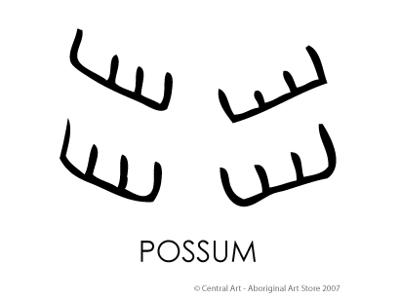
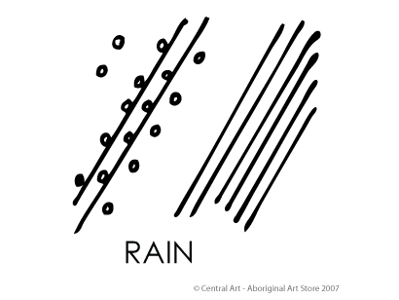
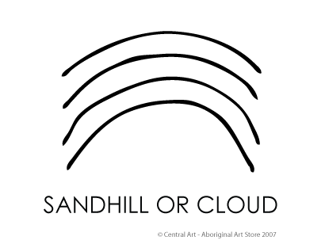
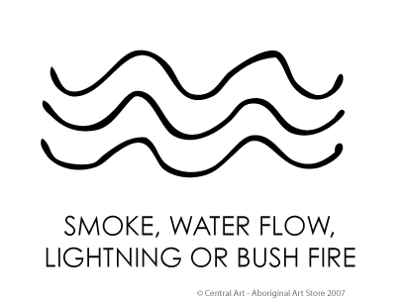

Slide 23





Slide 24




Slide 25


Slide 26


Slide 27
Aboriginal dot art Artists at Work
Janie Ward Nakamarra is an aboriginal artist
http://www.youtube.com/watch?v=uFgwtBYbUDc&feature=related
Aboriginal artist John Turnbull
http://youtu.be/XZihc8hWGtk

Slide 28
doing Aboriginal painting Video
http://youtu.be/L4OnT8RS8uM
http://www.youtube.com/watch?v=_wKOs7v5WZ0&feature=related FOR TEACHER

